Slide 1

Secure sharing of Identity(KYC)
Presenting By:
Guide
Mr.V.Hirish Reddy
Asst.Professor
Dept. of CSE(AI&ML)
VCET-HYD
M .Prashanth -22BT1A6643
K .Venkat -22BT1A6632
Y .Komali- 22BT1A6657
B .Raviteja -22BT1A6612
B. Aruna -22BT5A6601
T. Sai kumar-22BT1A6654

Slide 2
Topics to be covered
Abstract
Introduction
Problem statement
Objectives
Literature Survey
System Analysis( Existing and proposed )
System design/ architecture
Technologies used
Implementation( code / screen shots/ key modules)
Testing
Results
Conclusion
Future scope
Reference

Slide 3
Abstract
This project focuses on the secure sharing of identity (KYC) information using blockchain and decentralized storage technologies.
Users can upload their KYC documents, which are encrypted and stored on IPFS, while access control is managed through smart contracts.
The system ensures data integrity, privacy, and tamper-proof verification for authorized parties.
Verifiers can access KYC data only with user consent, promoting transparency and user control.
This solution reduces repetitive KYC processes and enhances trust in digital identity management.

Slide 4
Introduction
Know Your Customer (KYC) is an essential process for verifying the identity of users in financial and digital systems.
Traditional KYC methods are repetitive, time-consuming, and expose sensitive user data to security risks.
This project proposes a secure, decentralized KYC sharing system using blockchain and IPFS (InterPlanetary File System).
It enables users to store and share their KYC documents securely, with full control over who can access them.
The goal is to create a tamper-proof, privacy-preserving solution that improves efficiency and trust in digital identity verification.

Slide 5
Problem statement
Traditional KYC processes involve repeated submission and verification of identity documents across multiple institutions.
This leads to data duplication, inefficiency, and increased risk of data breaches.
Users have limited control over how their sensitive information is stored and shared.
Centralized storage systems are vulnerable to hacking and tampering.
There is a critical need for a secure, user-controlled system to share KYC information efficiently and reliably.

Slide 6
Objectives
To develop a secure and decentralized platform for storing and sharing KYC documents.
To ensure user privacy and data ownership using encryption and access control mechanisms.
To implement blockchain-based smart contracts for transparent and tamper-proof KYC verification.
To reduce redundancy by enabling one-time KYC submission usable across multiple platforms.
To improve trust and efficiency in digital identity verification processes.

Slide 7
Literature Survey
🔍 Traditional KYC Systems
Centralized databases
High risk of data breaches
Lack of user control
🔐 Blockchain in Identity
Decentralized & tamper-proof
Transparent verification
Enhances trust

Slide 8

Literature Survey
☁️ IPFS Storage
Distributed file system
Secure, scalable, and efficient
Ideal for storing KYC documents
⚙️ Smart Contracts
Automate KYC access control
Ensure data integrity and auditability
Reduce manual effort
📊 Research Insight
Combines security, privacy, and efficiency
Reduces data duplication
Streamlines onboarding process

Slide 9

System Analysis
✅ Existing System
Centralized KYC processes
Repetitive document submission
High risk of data leaks and manipulation
No user control over data access
❌ Limitations of Existing System
Time-consuming verification
Costly for institutions
Lack of transparency
Vulnerable to single-point failure

Slide 10

System Analysis
💡 Proposed System
Blockchain-based identity sharing
One-time KYC upload with controlled access
Encrypted document storage on IPFS
Smart contracts for secure, transparent approval
🔐 Benefits of Proposed System
Decentralized & tamper-resistant
User-controlled sharing
Improved efficiency & trust
Lower cost & redundancy

Slide 11

System Design
🧩 Key Components
User Interface (Frontend): Allows users to register, upload KYC, and give access permissions.
Smart Contracts (Blockchain Layer): Handles access control, verification status, and permission tracking.
IPFS (Storage Layer): Stores encrypted KYC documents in a decentralized way.
Verifier Dashboard: Enables institutions to request and verify user KYC with consent.

Slide 12

Architecture
User → Upload KYC → Encrypt & Store on IPFS
↓
Smart Contract ← Request Access ← Verifier
↓
Verify Permissions → Access KYC from IPFS
Security Features 🔒
End-to-end encryption of documents
Blockchain immutability
Permissioned data access only
No central point of failure

Slide 13

Technologies used
🔗 Blockchain Platform
Ethereum: For decentralized, immutable identity records
Smart Contracts (Solidity): Manage access permissions securely
Ganache & Truffle Suite: Local development & testing tools
☁️ Decentralized Storage
IPFS (InterPlanetary File System): For encrypted KYC document storage
💻 Development Tools
Frontend: HTML5, CSS3, JavaScript
Backend: Python (Flask / Django)
Web3.py / Web3.js: For blockchain interaction

Slide 14

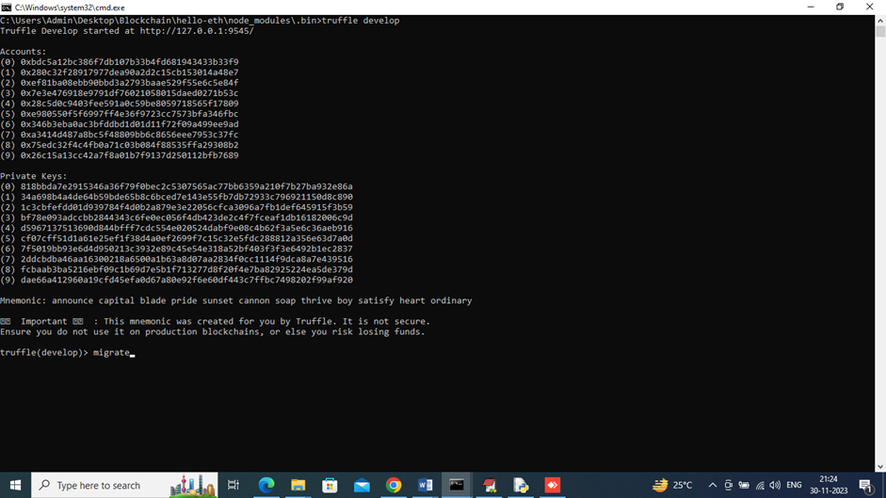
Implementation
First go inside ‘hello-eth/node-modules/bin’ folder and then find for ‘runBlockchain.bat’ file and then double click on that file to get below Ethereum screen
In side screen Ethereum started with default accounts and private keys and then type command as ‘migrate’ and then press enter key to deploy contract and get below screen

Slide 15

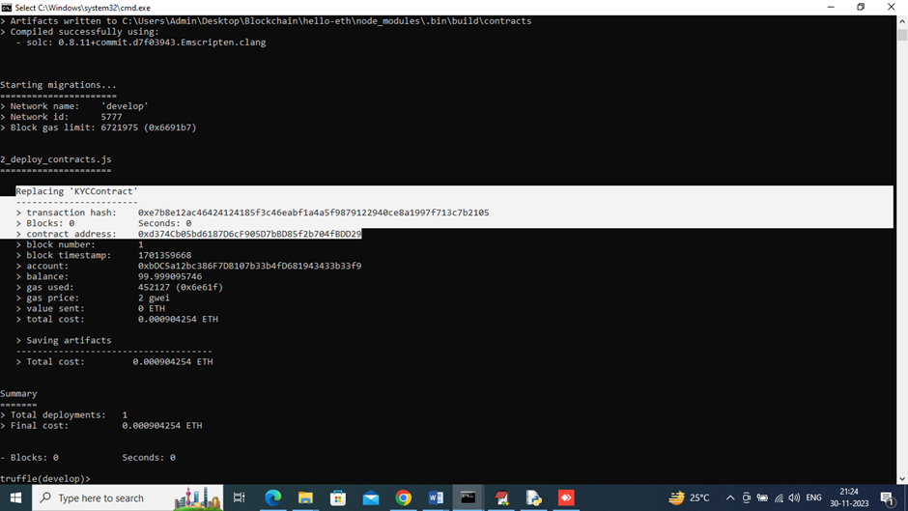
In side screen in white colour text can see KY Contract deployed and got contract address also and this address need to specify in PYTHON code to access that contract to store and get user data. In below screen showing python code calling smart contract
To implement this project, we have designed following modules
User module and Bank Admin Module

Slide 16

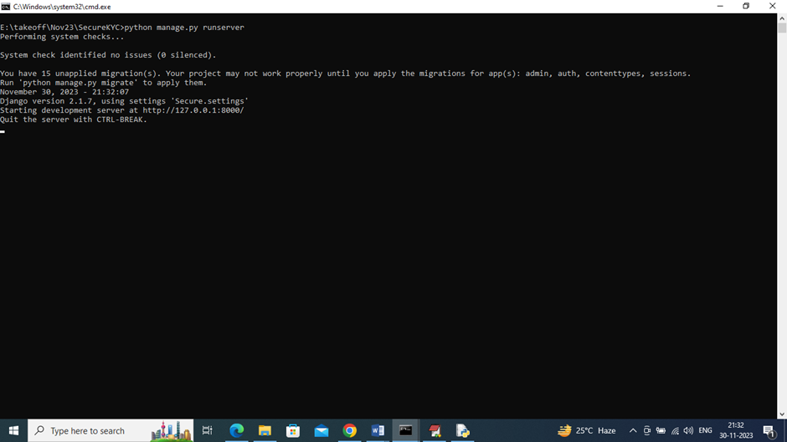
To run project double click on ‘runServer.bat’ file to start python server and get below page
In above screen python server started and now open browser and enter URL as ‘http://127.0.0.1:8000/index.html’ and press enter key to get below page

Slide 17

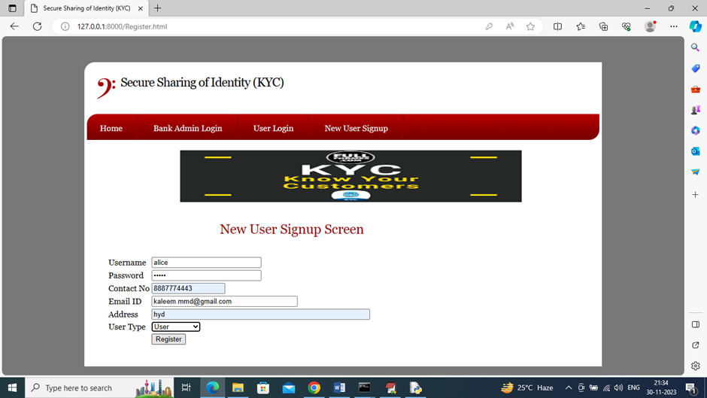
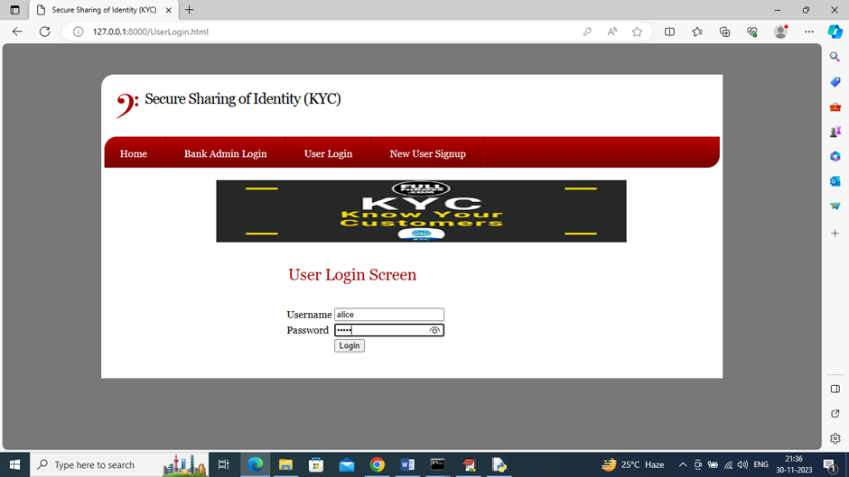
This screen shows new user sign up
This screen shows user login

Slide 18

Testing
Testing Approach for Secure KYC Systems
Functional Testing – Ensures all identity verification features work correctly.
Security Testing – Identifies vulnerabilities in data encryption, access control, and fraud detection.
Performance Testing – Evaluates system speed, scalability, and response time under high loads.
Usability Testing – Checks user experience, ease of navigation, and accessibility.
Compliance Testing – Verifies adherence to regulations like GDPR, AML, and local KYC laws.
Integration Testing – Ensures seamless interaction between KYC modules, databases, and third-party APIs.

Slide 19

RESULTS
Component | Test Coverage | Success Rate | Critical Issues Resolved
Smart Contracts | 100% | 98% | Reentrancy vulnerability fixed
Ethereum Network | 80%(load tests) | 99% | Gas fee optimization needed
IPFS Storage | 100% | 100% | None
Frontend/Backend | 90% | 95% | RPC time out handling improved

Slide 20

Conclusion
Conclusion: This blockchain-based KYC identity management system, successfully leverages Ethereum (PoS), IPFS, and smart contracts to achieve:
1.Immutable Identity Records – Tamper-proof storage on Ethereum.
2. Decentralized Security – No single point of failure; encrypted documents on IPFS.
3. Automated Access Control – Smart contracts enforce permissions without intermediaries.
Tested Reliability: High success rates in contract execution (98%) and data integrity (100%).
Challenges Addressed:
✔ Fixed smart contract vulnerabilities (e.g., reentrancy).
✔ Optimized gas fees for Ethereum transactions.
✔ Improved RPC timeout handling in frontend/backend.

Slide 21

FUTURE SCOPE
Area | Improvement | Impact
Zero-knowledge proofs (ZKPs) | Privacy-preserving KYC | Eliminates unnecessary data exposure while maintaining compliance.
Layer 2 solutions | Deploy on polygon or arbitrum for faster/cheaper | Scales beyond Ethereum’s
Oracles | Chain-link for real world KYC checks | Bridges off-chain trust into block chain
DAO governance | Tokenized voting for identity validators | Decentralizes trust further.
Biometric integration | Store hashed biometrics | Enhances security against impersonation.
Interoperability | Cross-chain IDs | Expands utility beyond Ethereum ecosystem.

Slide 22

Reference
J. P. Moyano and O. Ross, "KYC optimization using distributed ledger technology", Business & Information Systems Engineering, vol. 59, no. 6, pp. 411-423, 2017.
N. K. Ostern and J. Riedel, "Know-Your-Customer (KYC) Requirements for Initial Coin Offerings", Business & Information Systems Engineering, pp. 1-17, 2020.
D. De Smet and A. L. Mention, "Improving auditor effectiveness in assessing KYC/AML practices: Case study in a Luxembourgish context", Managerial Auditing Journal, 2011.
R. Syah, M. K. Nasution, M. Elveny and H. Arbie, "Optimization model for customer behavior with MARS and KYC system", Journal of Theoretical and Applied Information Technology, vol. 98, no. 13, 2020

Slide 23
Thank you

